Slide 1



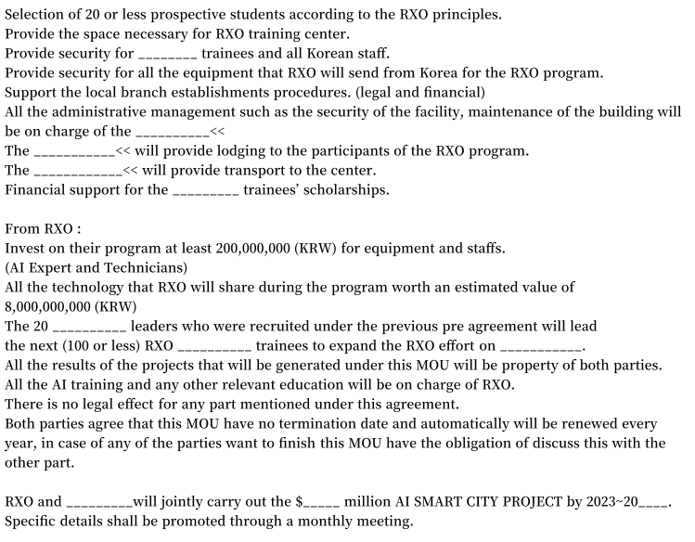





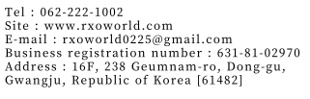
HEKATE
Hekate
Hekate Technology JSC
NGUYỄN VĂN MINH ĐỨC

Slide 2

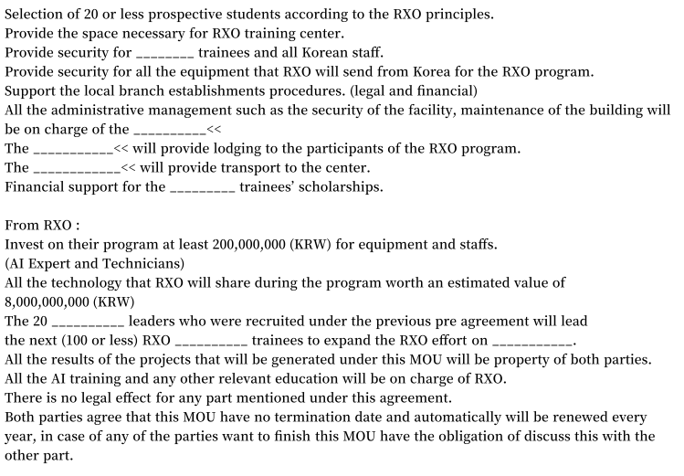

HEKATE
Hekate Technology JSC
NGUYỄN VĂN MINH ĐỨC

